Slide 1
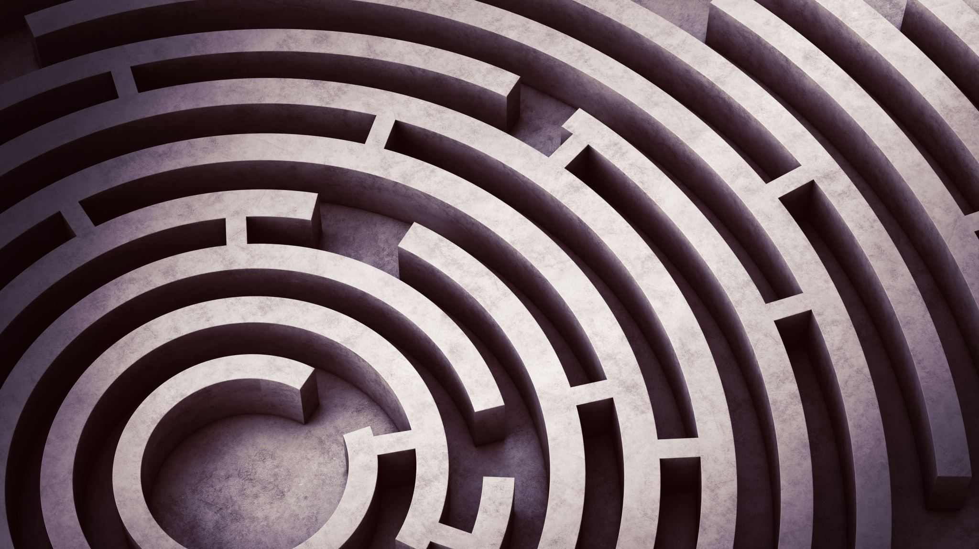
Mazes
Author: William Lawson Smith

Slide 2
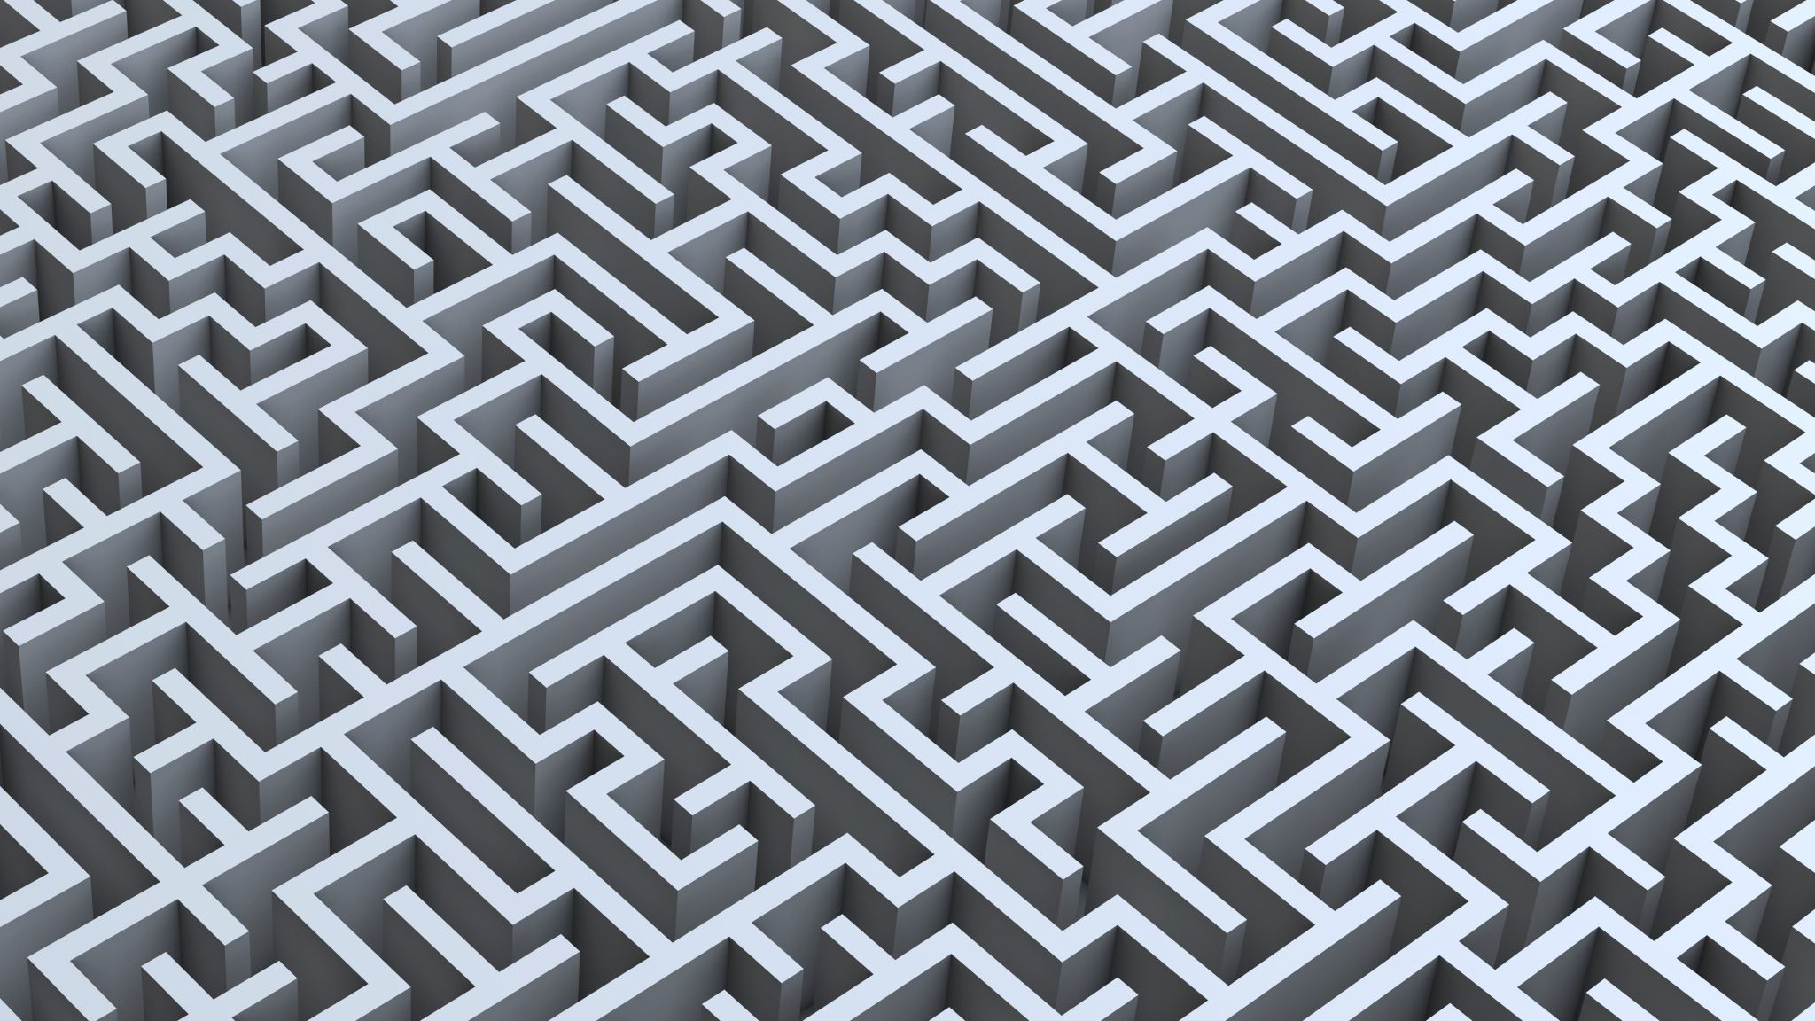
What is a “Perfect” Maze?

Slide 3
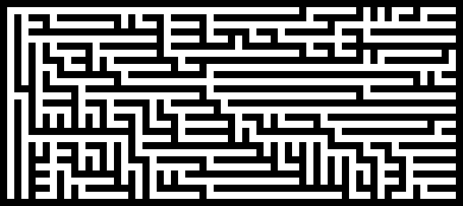
In Computer Science a “perfect” maze is one where there is one and only one path from any one cell to any other cell.
A “perfect” maze solution algorithm is one that solves “perfect” mazes.
We will explore two “perfect” maze creation algorithms and solve the resulting mazes with two “perfect” maze solution algorithms.
The demonstrations here do not represent time to complete. At this scale, most of these algorithms are nearly instantaneous.
The mazes are solved from the top left to the bottom right.

Slide 4

Perfect Maze Creation Algorithms

Slide 5
Hunt and Kill
A Perfect Maze Creation Algorithm
Notes:
It’s nice, I promise.

Slide 6
How it Works
This algorithm starts like the Recursive Backtracker.
It explores a randomly picked cell adjacent to the starting cell and sets the new cell as the current cell.
It then randomly picks a cell adjacent to the current cell, explores the new cell, sets the new cell as the current cell, and repeats this process until it dead ends into itself.
When this happens, the program “Hunts” through the maze, looking for an explored cell adjacent to an unexplored cell.
If it finds an acceptable cell, it sets this as the new current cell and repeats the process.
If it scans the entire maze and does not find an acceptable cell, that means that the maze has been created and the program ends.

Slide 7
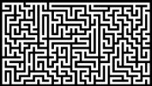
Full Length Demo
Key:
White Cells = Explored
Gray Cells = Unexplored
Black Cells = Walls
Red Cells = Current Cell
Blue Cells = Cell Being Tested For Unexplored Neighbors

Slide 8
Short Demo
Key:
White Cells = Explored
Gray Cells = Unexplored
Black Cells = Walls
Red Cells = Current Cell
Blue Cells = Cell Being Tested For Unexplored Neighbors

Slide 9
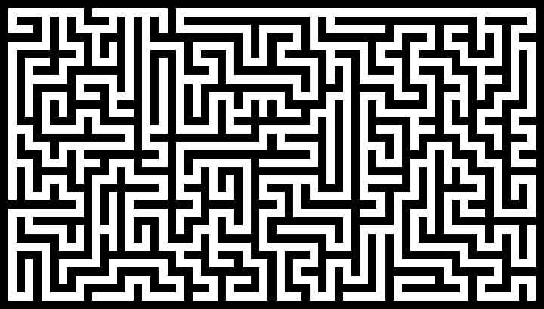
Example for Print
Maze made using Hunt and Kill creation algorithm.

Slide 10
Growing Tree
Another Perfect Maze Creation Algorithm

Slide 11
How it Works
A starting cell is added to a list and is set as the current cell. An unexplored neighbor of the current cell is randomly chosen, explored, and added to the list.
A cell is then chosen from the list and is set as the current cell.
If the current cell has no unexplored neighbors, it is removed from the list.
If it has any unexplored neighbors, one of them is randomly chosen, explored, and is added to the list.
This is repeated until there is nothing left in the list.

Slide 12

How to Choose the Current Cell
The interesting part is how you choose what cell from the list is set to be the current cell.
If you choose the last (or most recent) cell on the list, the algorithm mimics (or effectively becomes) the Recursive Backtracker Algorithm.
If you randomly choose a cell from the list, the algorithm produces similar results to prim’s algorithm.
If you always choose the first cell on the list, the maze becomes very “blocky.”
You can combine various ways of selecting your current cell to get some interesting textures.
In the demonstrations in the next few slides, the first cell on the list was chosen 65% of the time and a randomly chosen cell from the list was chosen 35% of the time.
A maze made using the “blocky” selection method.

Slide 13
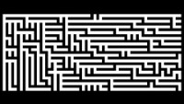
Full Length Demo
Key:
White = Explored
Gray = Unexplored
Black = Wall
Red = Current Cell
Blue = Cell Being Added to List

Slide 14
Short Demo
Key:
White = Explored
Gray = Unexplored
Black = Wall
Red = Current Cell
Blue = Cell Being Added to List

Slide 15
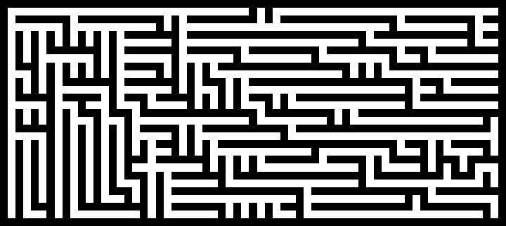
Example for Print
Maze made using Growing Tree creation algorithm where the first cell on the list was chosen 65% of the time and a random cell from the list was chosen 35% of the time.

Slide 16

Perfect Maze Solution Algorithms
Algorithms to Solve Perfect Mazes

Slide 17
Dead End Filling
A Perfect Maze Solution Algorithm

Slide 18
How it Works
The algorithm systematically scans through the array looking for any cell that has only one non filled neighbor (aka dead end).
It fills the discovered dead end unless it is the start or the end.
It repeats these steps until there are no more dead ends left.
This results in a path of unfilled cells from the start to the end.

Slide 19
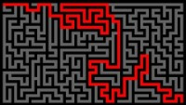
Full Length Demo No. 1
This demo is solving a maze created by the Hunt and Kill maze creation algorithm.
Key:
White = Unexplored Cell
Black = Wall
Gray = Filled in Cell
Blue = Cell Being Filled In
Red = Path

Slide 20
Short Demo No. 1
This demo is solving a maze created by the Hunt and Kill maze creation algorithm.
Key:
White = Unexplored Cell
Black = Wall
Gray = Filled in Cell
Blue = Cell Being Filled In
Red = Path

Slide 21
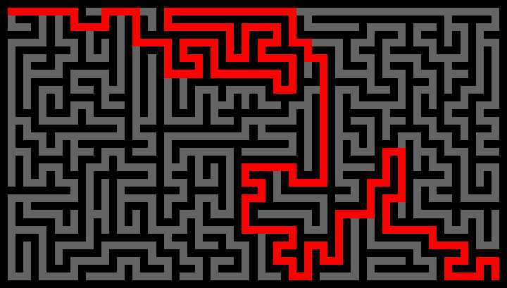
Example for Print No. 1
Maze created with the Hunt and Kill algorithm solved with the Dead End Filler algorithm.

Slide 22
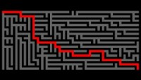
Full Length Demo No. 2
This demo is solving a maze created by the Growing Tree maze creation algorithm.
Key:
White = Unexplored Cell
Black = Wall
Gray = Filled in Cell
Blue = Cell Being Filled In
Red = Path

Slide 23
Short Demo No. 2
This demo is solving a maze created by the Growing Tree maze creation algorithm.
Key:
White = Unexplored Cell
Black = Wall
Gray = Filled in Cell
Blue = Cell Being Filled In
Red = Path

Slide 24
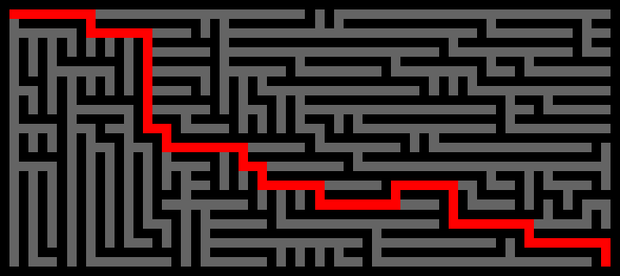
Example for Print No. 2
Maze created with the Growing Tree algorithm solved with the Dead End Filling algorithm.

Slide 25
Shortest Path Finder
Another Perfect Maze Solution Algorithm

Slide 26
How it Works
The starting cell is filled with “water.”
The cells filled with “water” fill all unfilled adjacent cells with “water,” and the cells record what cell they were filled by.
This is repeated until either the maze is filled with “water,” or until the end is filled.
The path is then traced from the end back to the start by following which cell filled which from the end to the start.

Slide 27
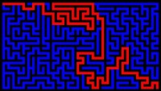
Full Length Demo No. 1
This demo is solving a maze created by the Hunt and Kill maze creation algorithm.
Key:
White = Unfilled Cell
Black = Wall
Blue = Cells Filled With “Water”
Yellow = Cells Being Filled
Red = Path

Slide 28
Short Demo No. 1
This demo is solving a maze created by the Hunt and Kill maze creation algorithm.
Key:
White = Unfilled Cell
Black = Wall
Blue = Cells Filled With “Water”
Yellow = Cells Being Filled
Red = Path

Slide 29
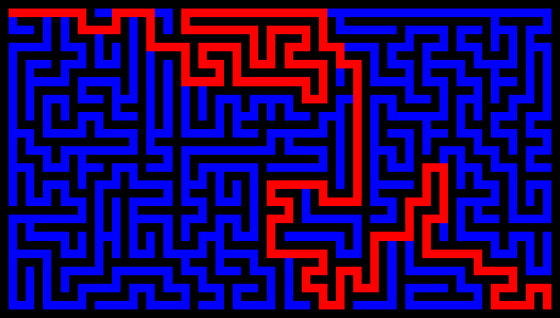
Example for Print No. 1
Maze created with the Hunt and Kill algorithm solved with the Shortest Path Finder algorithm.

Slide 30
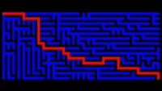
Full Length Demo No. 2
This demo is solving a maze created by the Growing Tree maze creation algorithm.
Key:
White = Unfilled Cell
Black = Wall
Blue = Cells Filled With “Water”
Yellow = Cells Being Filled
Red = Path

Slide 31
Short Demo No. 2
This demo is solving a maze created by the Growing Tree maze creation algorithm.
Key:
White = Unfilled Cell
Black = Wall
Blue = Cells Filled With “Water”
Yellow = Cells Being Filled
Red = Path

Slide 32
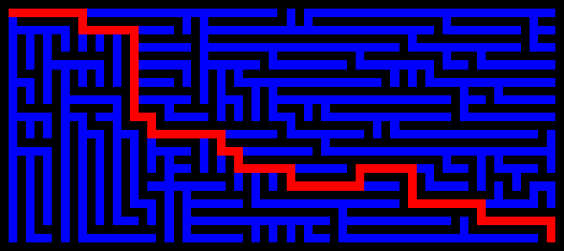
Example for Print No. 2
Maze created with the Growing Tree algorithm solved with the Shortest Path Finder algorithm.

Slide 33
Links to Project
GitHub: https://github.com/W-L-Smith-2022/Maze-Creation-and-Solution-Algorithms
YouTube Playlist of Visualizations: https://www.youtube.com/playlist?list=PLDQ-bcm9sjaUVhJ3mAJmWygHiuV5zggHo
YouTube Video: https://youtu.be/_z4aos8tM2M

Slide 34
Learn More about Mazes
https://www.astrolog.org/labyrnth/algrithm.htm
https://www.jamisbuck.org/mazes/

